Slide 1
Climate Change project update: week 3
Rens Breunissen,
Lotte van Dongen,
Markus Peschl,
Cecilia Casolo,
Maaike Elgersma,
Eva Slingerland,
Simon van Oosterom
Supervised by
Lorinc Meszaros [Deltares]
Robbert Fokkink [TU Delft]
Mathematical Data Science

Slide 2
This week we worked on:
We expanded the clustering algorithms and analysis
We started using Neural Networks in order to make predictions

Slide 3
Clustering
We removed a bug in the data preperation part of the code
We created a script which analyzes the physical properties of a cluster
We improved the algorithms which give insight in the clusters for the first and last 10 years
We generalized the code in order to compare different stations
We implemented a second clustering algorithm (DBSCAN)

Slide 4
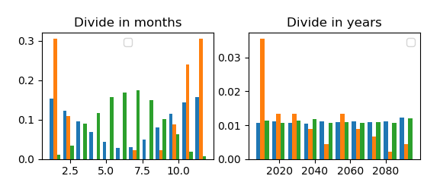
Removing a bug:
Last week we presented this figure:
All points in the orange cluster are identical, due to an error in the removing of NaN points (it only contains ~50 points out of the 30000)

Slide 5
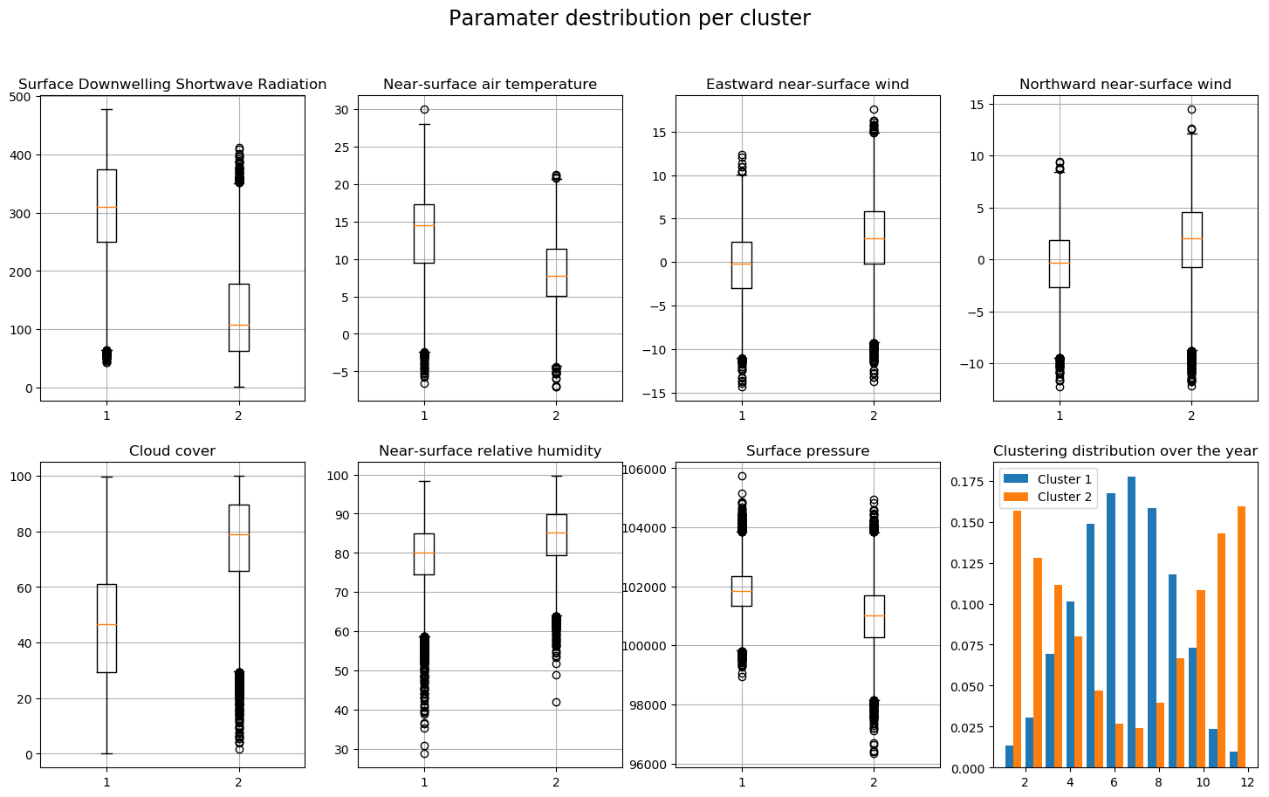
Analyzing the clusters
When we remove the orange cluster, we are left with two clusters roughly representing summer and winter.
Here we see the properties of these clusters
Looked at the difference between the distributions of each variable in the two clusters (left is summer cluster, right is winter cluster). A large difference means that it is an important indicator for differentiating between summer and winter.
2 Clusters

Slide 6
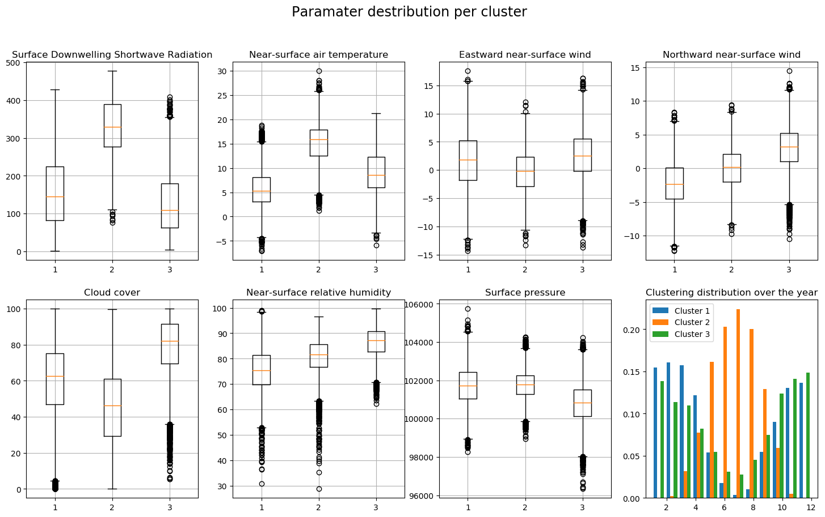
Analyzing the clusters
When we remove the orange cluster, we are left with two clusters roughly representing summer and winter.
Here we see the properties of these clusters
Looked at the difference between the distributions of each variable in the two clusters (left is summer cluster, right is winter cluster). A large difference means that it is an important indicator for differentiating between summer and winter.
3 Clusters

Slide 7
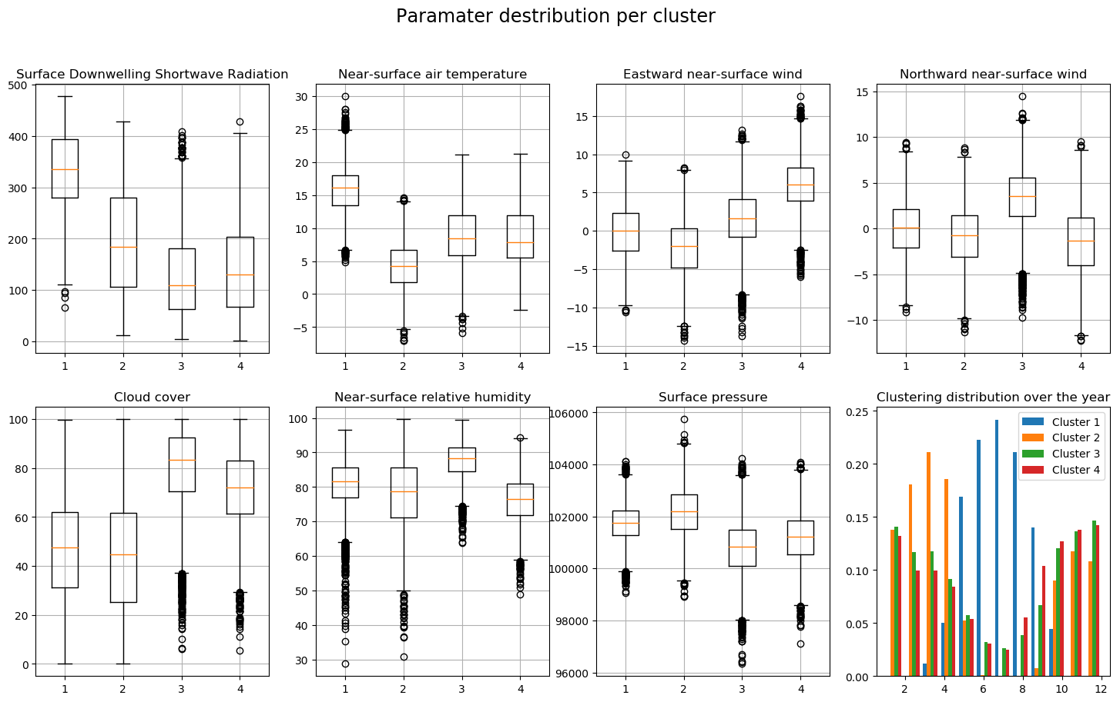
Analyzing the clusters
When we remove the orange cluster, we are left with two clusters roughly representing summer and winter.
Here we see the properties of these clusters
Looked at the difference between the distributions of each variable in the two clusters (left is summer cluster, right is winter cluster). A large difference means that it is an important indicator for differentiating between summer and winter.
4 Clusters

Slide 8
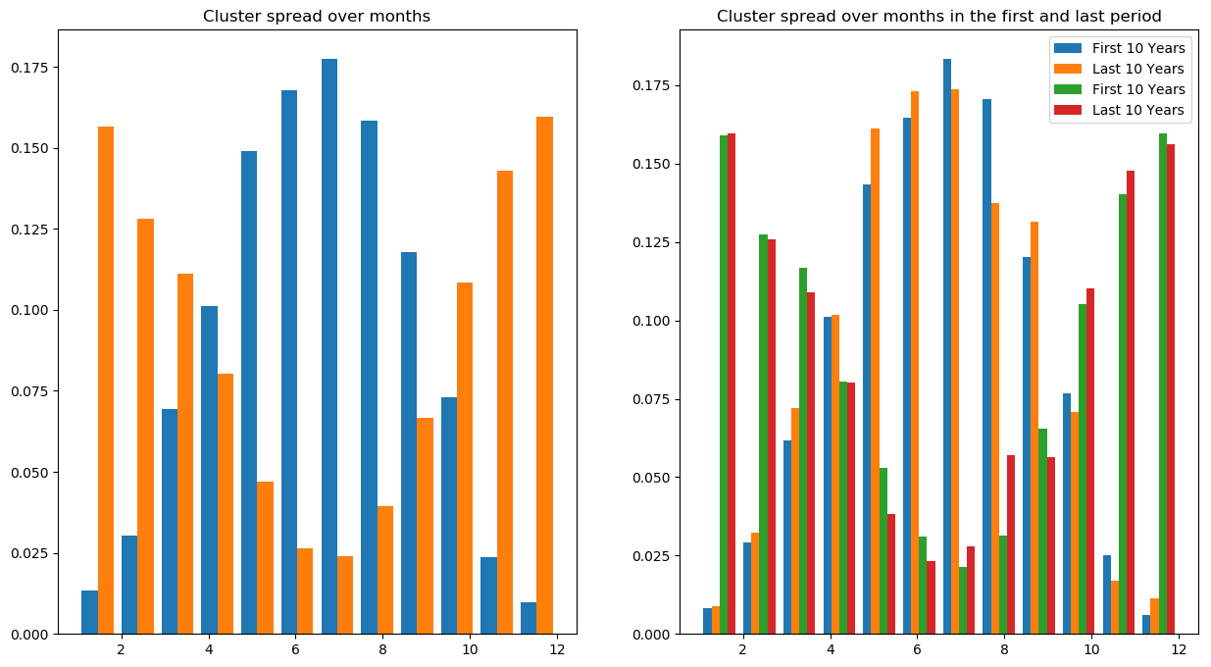
The first and last years
In order to see how climate change influences the composition of the clusters, we looked at what part of the days goes to what cluster
2 clusters:

Slide 9
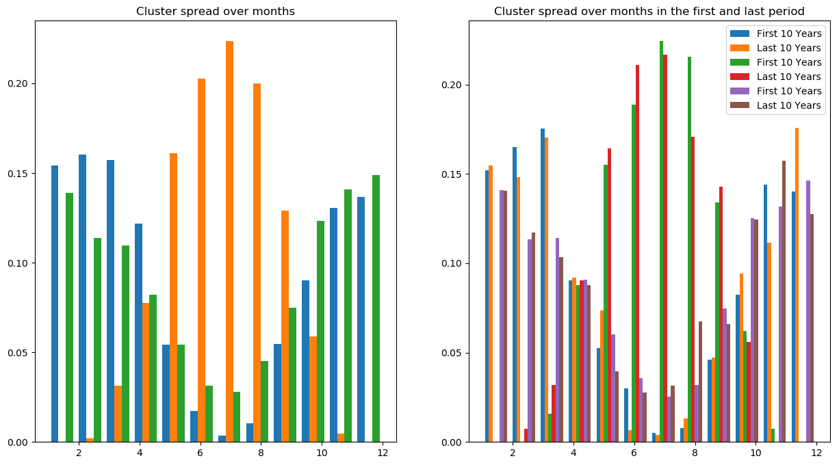
The first and last years
In order to see how climate change influences the composition of the clusters, we looked at what part of the days goes to what cluster
3 clusters:

Slide 10
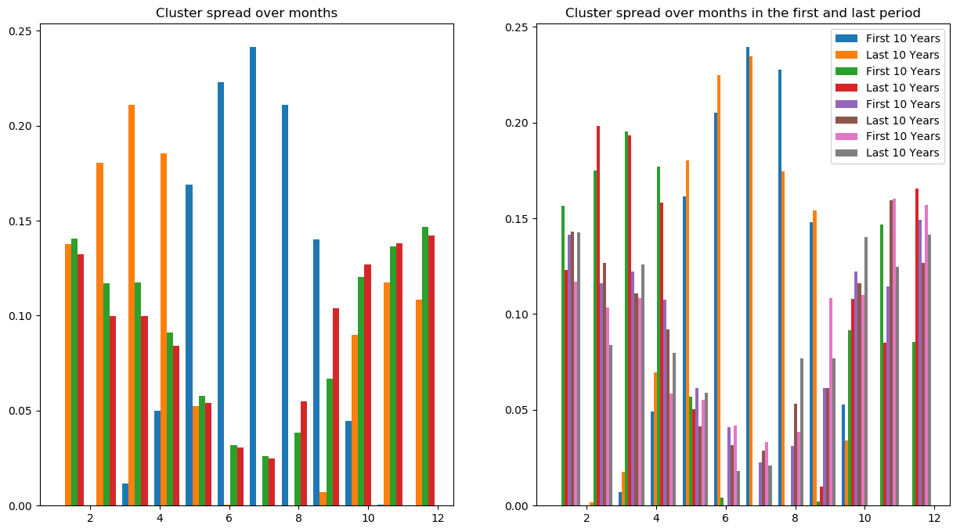
The first and last years
In order to see how climate change influences the composition of the clusters, we looked at what part of the days goes to what cluster
4 clusters:

Slide 11
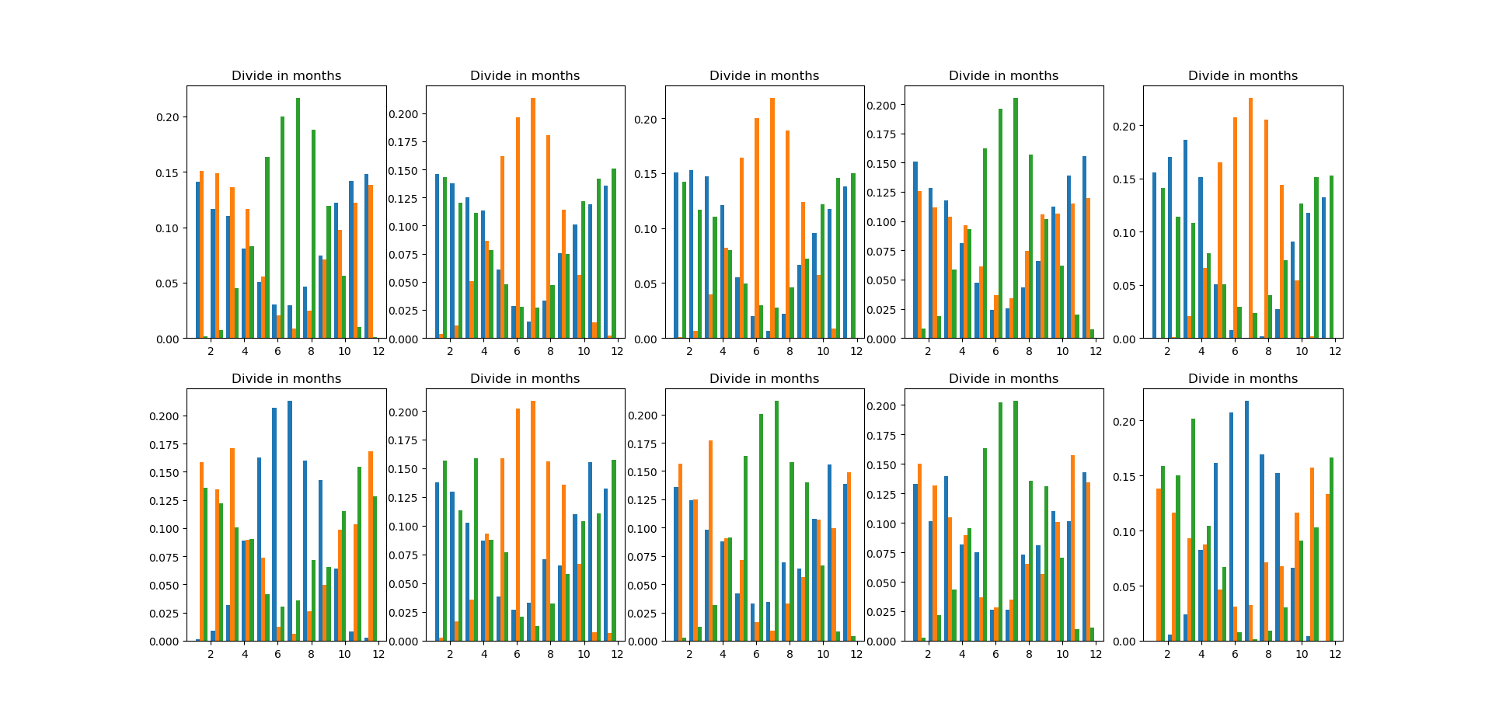
Comparing different stations
Tried to see if clusters were different for different stations, wasn’t the case, see image on the right. This shows from left to right the clustering results for stations 1-5. Top shows clustering for first 10 years, bottom shows clustering for last 10 years.

Slide 12
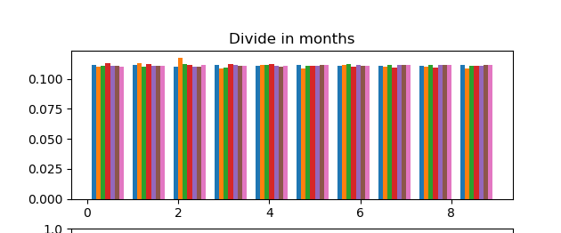
Comparing different stations
Setup: standardized all variables, so gave all variables mean zero, variance 1. Next, applied Kmeans clustering for 1 station.
Fixed a bug that gave weird results.
Tried to see if we could cluster per station, wasn’t successful. Image shows the relative amount of points of each cluster, per station. Everything almost the same, as expected since data points between different stations don’t differ much, so clustering will most likely cluster based on seasons, and not on location.

Slide 13
Clustering final remarks
We implemented the DBSCAN algorithm, but this was relatively time consuming with respect to the gained improvement
Question: What is the best way to quantify the difference in characteristics of the clusters (both in physical variables (temperature ect.) and distribution during the year) in a scientific appropriate way? Important since the histograms get messy for large number of clusters

Slide 14
Model prediction
Furthermore, we looked into the possibility of predicting the variables from one model based on the values from another model and a part of its own history.
First steps into multi linear regression were done, however the results will be shown next week.
Other methods used are neural networks and K-means

Slide 15
Model Prediction using dense ANN’s
Experimental Setup. Splitting data into training and test sets: We took the first 1000 days from two different models and created a labeled training set from that. This means the input is a vector of variables for one day of model 1 and the label is the vector of variables for model 2.
The task is to predict from a vector of observations for model 1 the corresponding vector of observations for model 2. Note that we did not (yet) use recurrent neural networks to take into account the relationship between different time steps. However, already for a simple dense ANN the results are surprisingly pretty convincing.

Slide 16
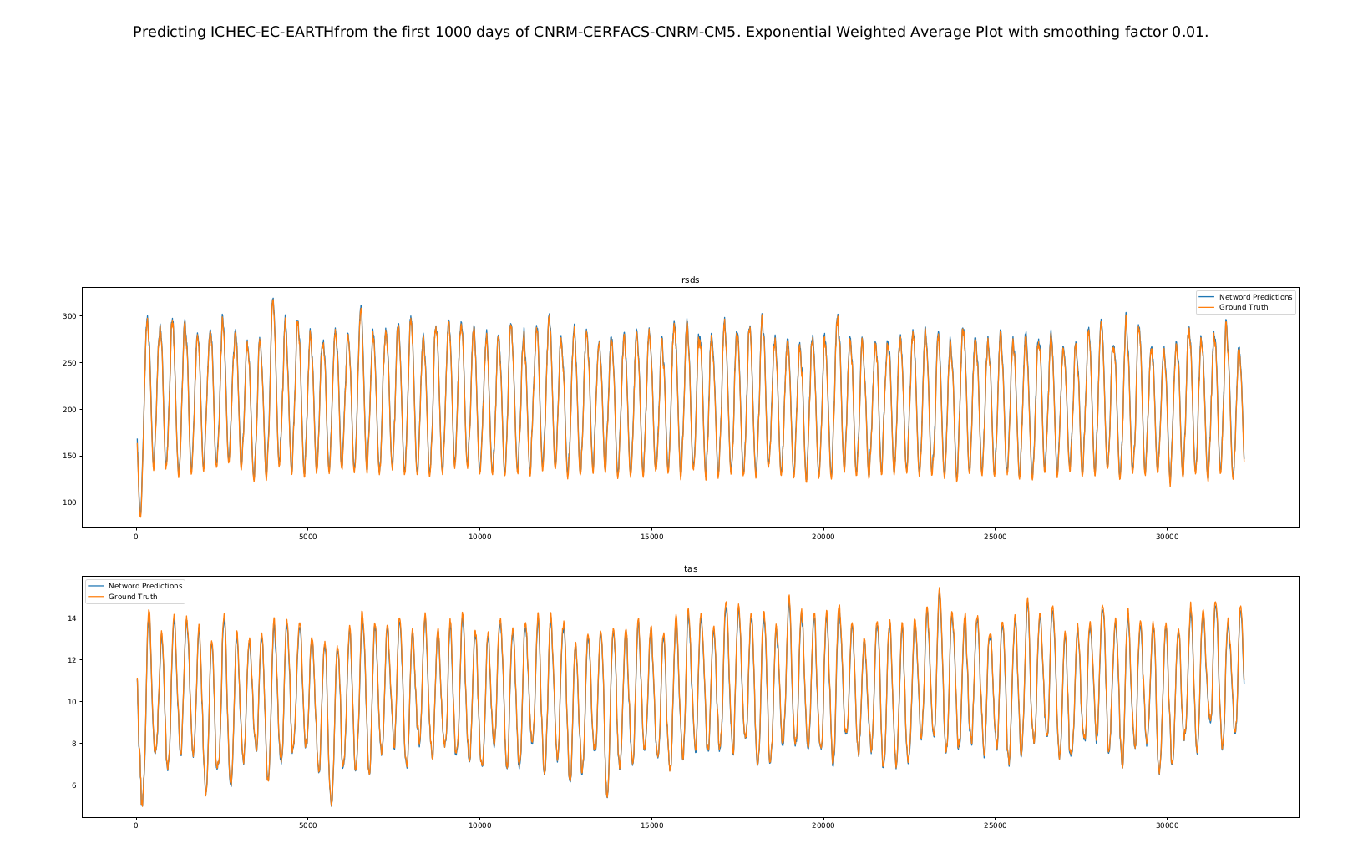

Slide 17
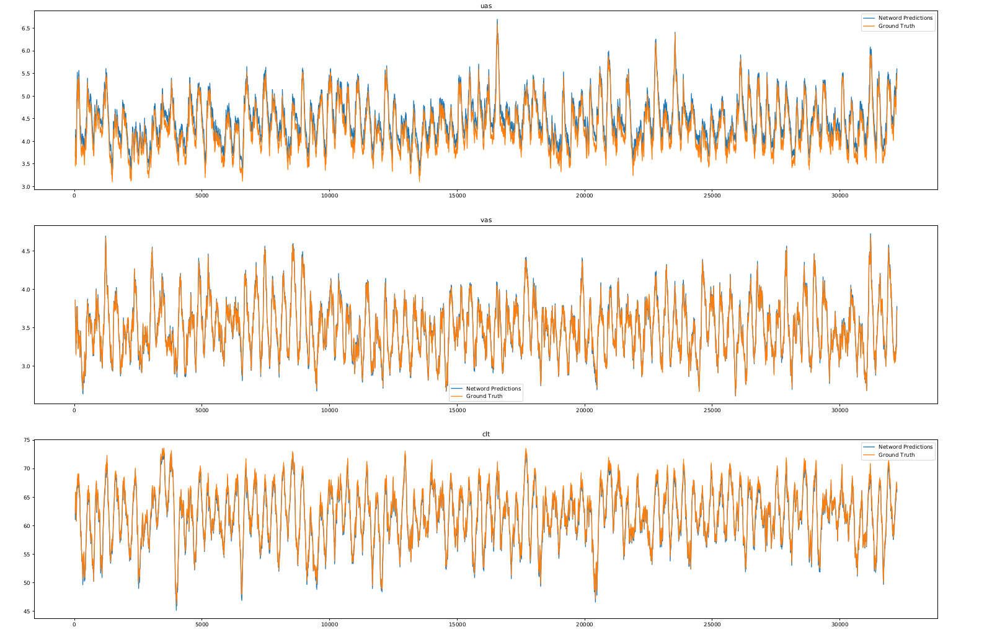

Slide 18
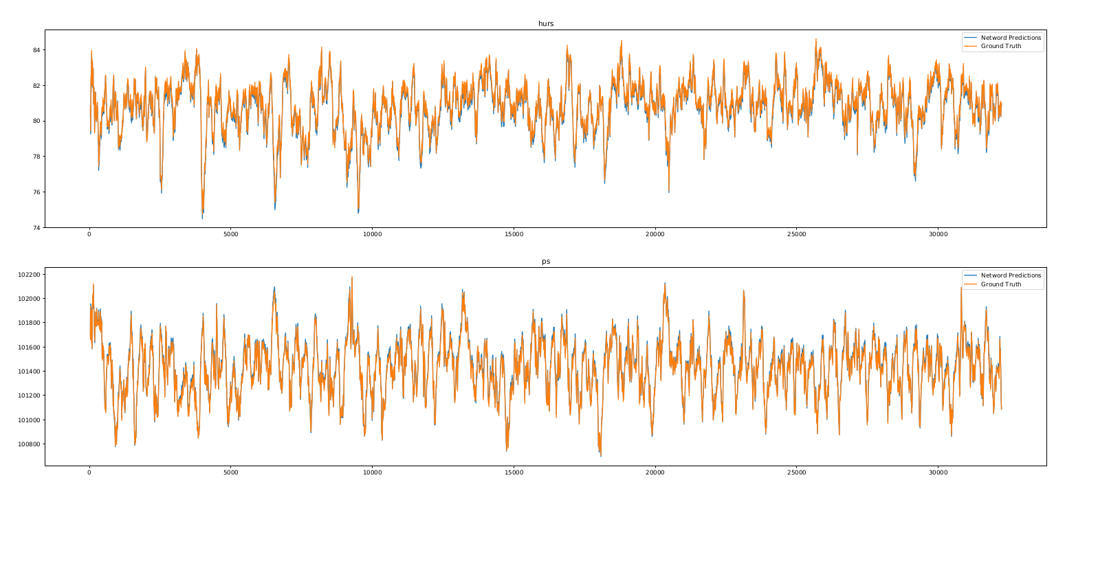

Slide 19
Model Prediction using dense ANN’s final remarks
To do: Generalize this to different models and compare performances as well as to play around with the training set size (e.g. only having the first 100 days poses a bigger challenge since the network never gets to see certain months)
Questions that arise here: How to make the task more challenging? What other predictions could be useful in this context?

